Slide 1
How to Read Papers

Slide 2
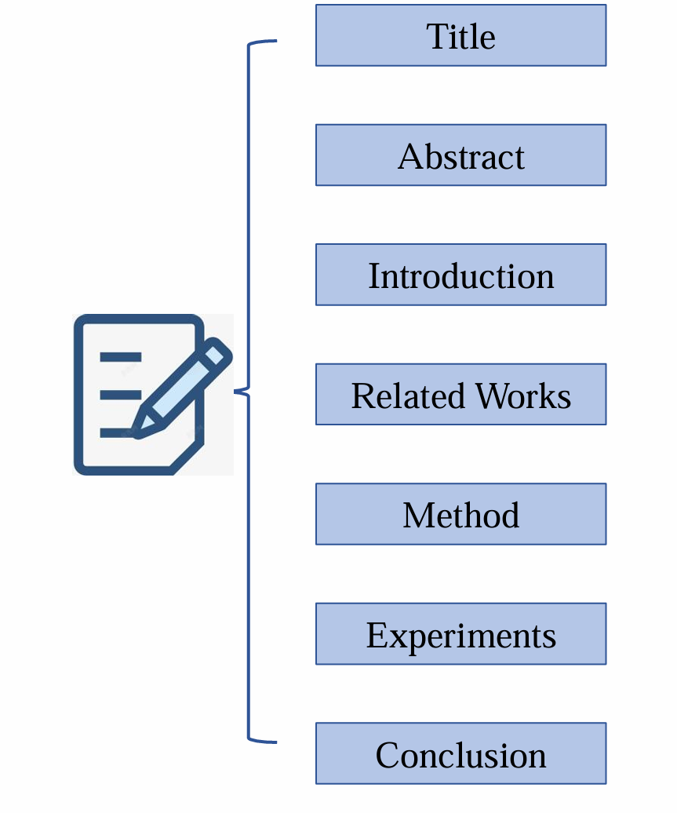
The structure of papers
Concise and attention-grabbing.
A summary of your work and contributions, including the research background, objectives, main findings, and significant conclusions.
An extended version of the Abstract, with more concrete details.
A comparison between your work and previous studies.
Focusing on the innovation points and the logical framework of the model.
Highlighting the results and significance of this study.
Similar to the Abstract but not repetitive, with a stronger emphasis on experimental results and conclusions.

Slide 3
Read a paper in three passes
First pass (least time-consuming, for initial filtering)
Second pass (for further selection of relevant papers)
Third pass (in-depth reading)

Slide 4
First Step
In the first pass, focus on the title and abstract.
After reading the abstract, skip directly to the conclusion section.
By reading these three sections, you can roughly understand the main topic of the paper.

Slide 5
Second Step
In the second pass, go through the entire paper to understand the purpose of each section.
You can read from the title through to the end, but there is no need to focus too much on details or proofs of formulas at this stage.

Slide 6
Points of focus
During the second pass, it is crucial to understand the key figures and tables and the purpose of every detail in them.
How does the author's proposed method compare to others, and what are the differences?
You may not fully understand everything at this point, but that’s fine. You can mark the unclear parts and revisit them in the third pass.
Outcome
After completing the second pass, you should have a general understanding of each part of the paper.
You can highlight the references cited by the author, such as improvements made on a particular method.
Note that if the author cites important references you haven’t read, you should list them as part of your reading queue.
Implications for further reading After this pass, evaluate the quality of the paper and its relevance to your research direction to decide whether to proceed with a detailed third pass.
Implications for further reading
After this pass, evaluate the quality of the paper and its relevance to your research direction to decide whether to proceed with a detailed third pass.

Slide 7
Third Step
The third pass is the final and most detailed one, where you need to understand every sentence and paragraph.
As you read, consider questions such as:
For instance, if I were to write this paper, how would I organize its structure?
When reading the experimental section, think about how the author described their experiments and whether you could have done it better.
During this pass, ensure you understand every word and sentence, and try to mentally visualize the entire process as if you were conducting the experiments and writing the paper yourself.
If you encounter difficulties, use tools like mind maps or flowcharts to visualize the entire process, which can help you better understand the paper.

Slide 8
Let’s explore the reading approach of the classic paper AlexNet. Reading classic works is a crucial first step for every scholar. Even though we may have already learned the related content and gained deep understanding, revisiting classic works is always enlightening.
When reading classic literature, we can approach it from three main perspectives:
Perspective One: Imagine we are in the year the paper was published; how should we read it?
Perspective Two: Imagine we have not learned subsequent knowledge. After reading this paper, can we come up with innovative ideas on our own, and how do they align with the current knowledge?
Perspective Three: Is this paper outdated today, and can we extract the core ideas from it?

Slide 9
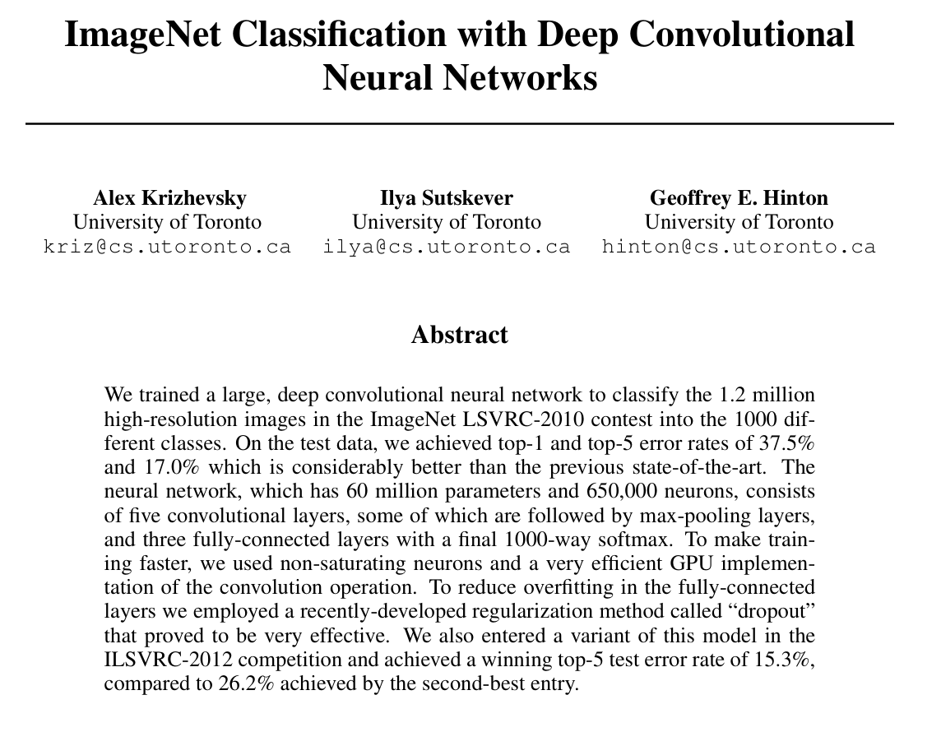
First Step
focus on the title and abstract.
I will only take the first step as an example, because the second and third steps are based on the assumption that you want to continue reading the paper. However, this paper might not be of interest to you, or it might not be in your research direction. The first step, however, I believe is universal and helps you directly extract the core content of the paper.

Slide 10
What: What was done?
A large-scale, deep convolutional neural network ,which was trained to classify 1.2 million images across 1000 categories.
Outcome: How effective was it?
The results outperformed previous work:
Top-1 error rate: 37.5%
Top-5 error rate: 17%
What does the network look like?
The network contains 6 million parameters and 650,000 neurons:
5 convolutional layers (fewer than 5 max-pooling layers) + 3 fully connected layers (1000-way softmax)
How to train faster with so many parameters?
Non-saturating neurons were used, and GPU acceleration was leveraged for convolution operations.
With so many parameters, how to prevent overfitting?
To prevent overfitting in the fully connected network (FCN), dropout regularization was employed, yielding effective results.
If you are interested, you can continue reading in the second and third steps.

Slide 11
Thank you for listening

